Slide 1
Updating Tables

Slide 2
Modifying Table Data
Three statements that change table data:
INSERT
UPDATE
DELETE
All three statements can modify a single row or a set of rows in a table

Slide 3
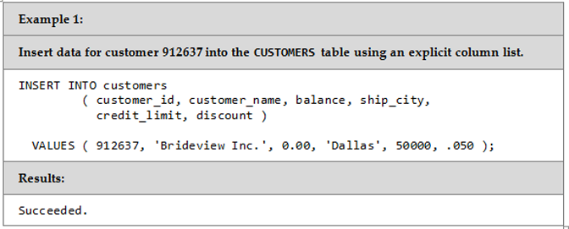
INSERT Statement Explicit Column Names

Slide 4
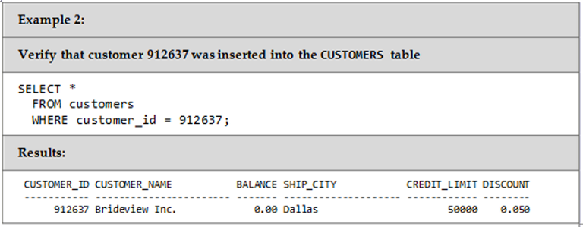
Verify INSERT Worked

Slide 5
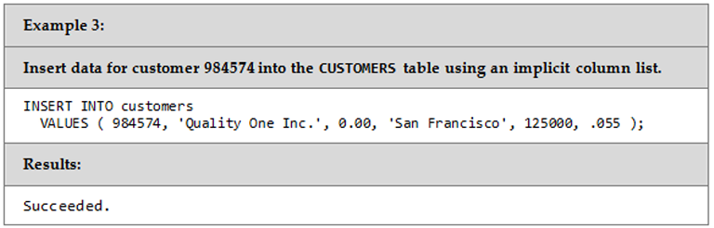
INSERT Statement Implicit Column Names

Slide 6
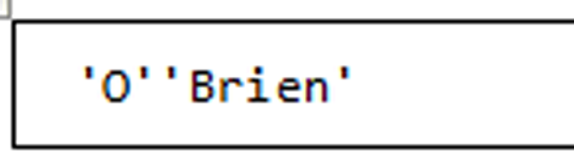
Apostrophe

Slide 7
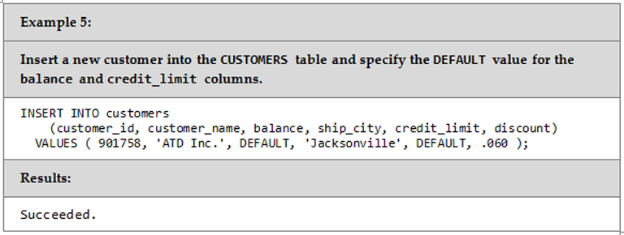
Explicit Default With INSERT

Slide 8
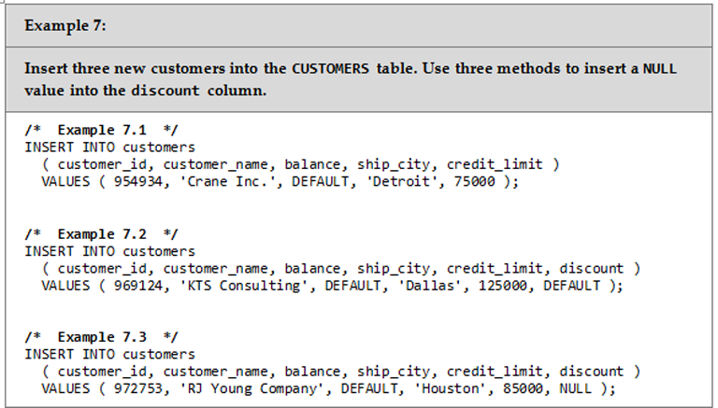
Inserting Rows with NULL Values

Slide 9
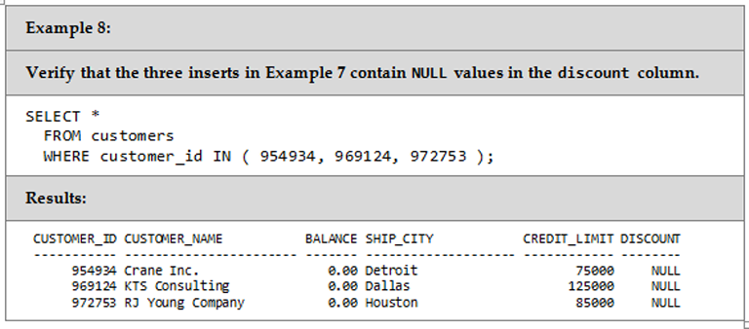
Verify NULL values from INSERTs

Slide 10
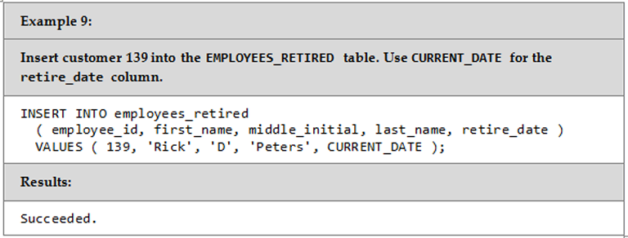
Specifying A Default Date

Slide 11
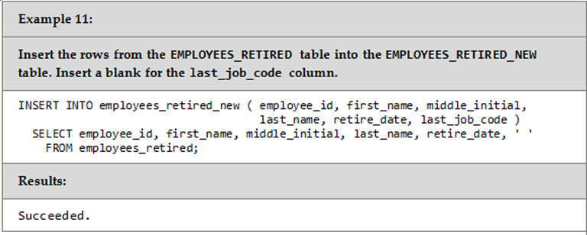
Multiple-Row INSERT Statement

Slide 12
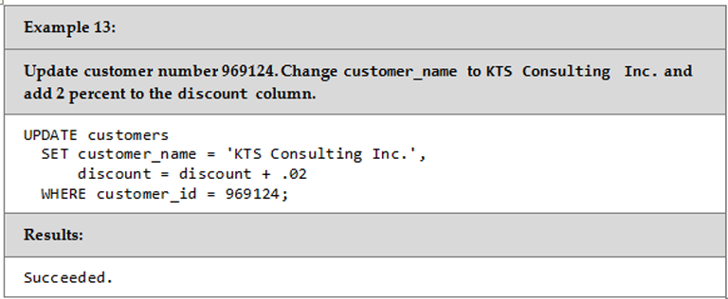
UPDATE Statement One Row in the Table

Slide 13
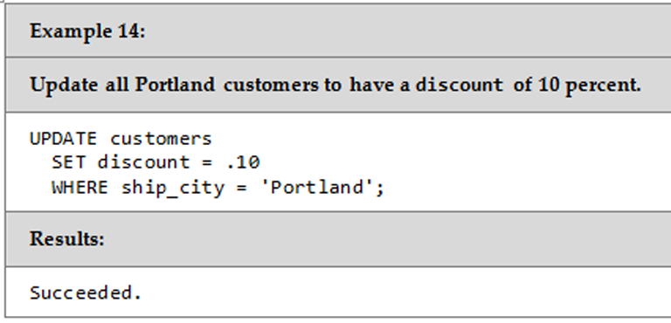
UPDATE Statement Multiple Rows in the Table

Slide 14
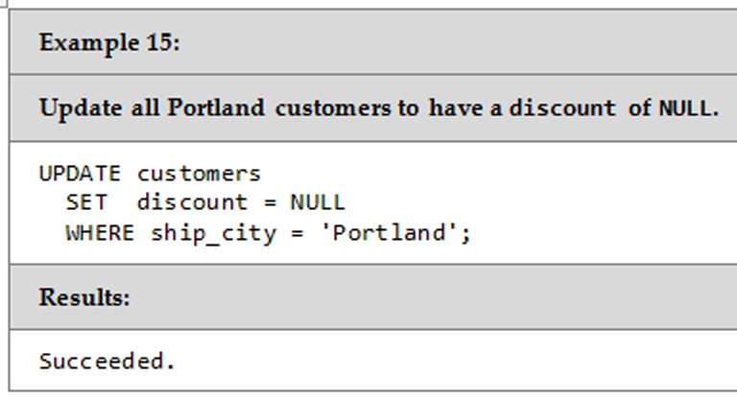
UPDATE Statement Set Null-Capable Column to NULL

Slide 15
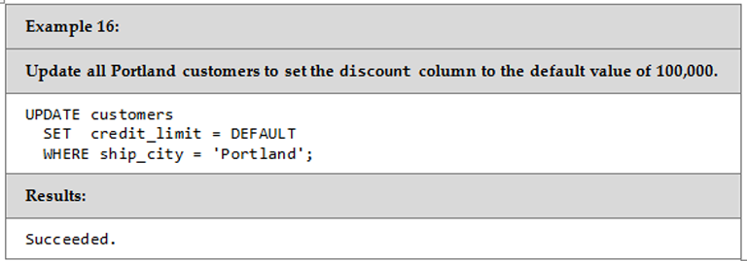
UPDATE Statement Set Column to Default Value

Slide 16
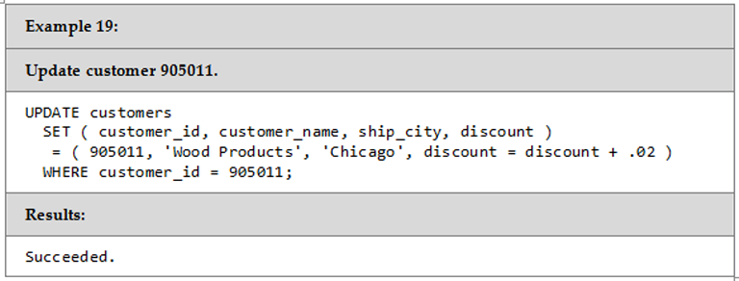
SET Clause Variation

Slide 17
Integrity Constraint Errors
Constraints are automatically checked whenever a DML statement is executed against a column
If any constraint rule would be broken as a result of the update, the table is not updated and an error is returned

Slide 18
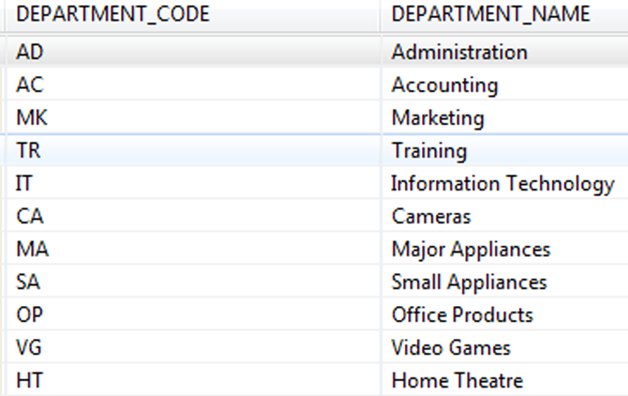
Integrity Constraint Errors

Slide 19
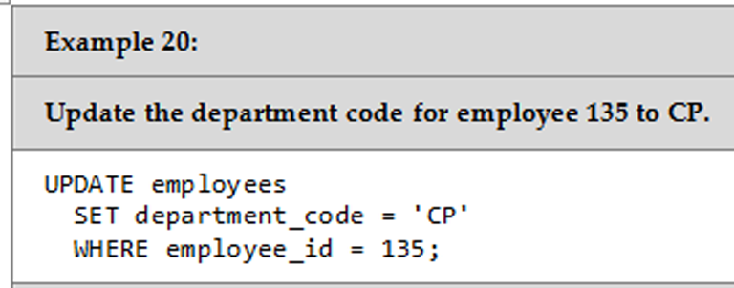
Integrity Constraint Errors

Slide 20
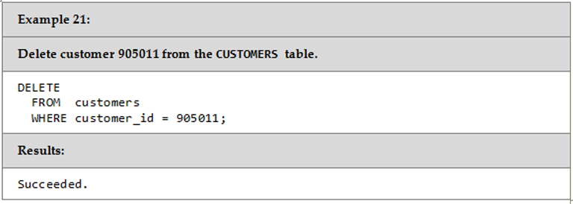
DELETE Statement One Row

Slide 21
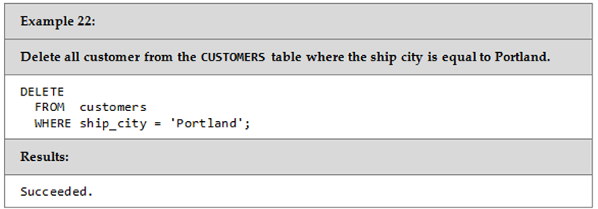
DELETE Statement Multiple Rows

Slide 22
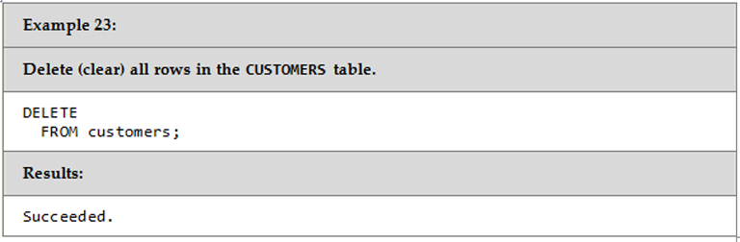
DELETE Statement What happens here?

Slide 23
ALTER TABLE Adding a New Column to an Existing Table
When you add a new column to an existing table, you have three options:
Make it NOT NULL, in which case you must supply a value to insert into the column for every row using the WITH DEFAULT clause.
Make the column NULL capable, in which case the DBMS will insert NULL values into the columns
Make it NULL capable and give it a default value

Slide 24
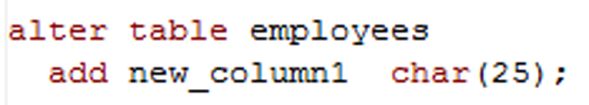
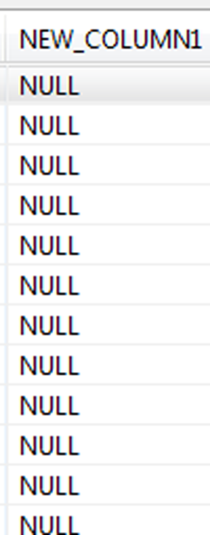
DELETE Statement What happens here?

Slide 25
The End ☺

